Slide 1



Urban Security Analysis in the City of Bogotá Using Complex Networks
André Ferreira
Guillermo Rubiano
Eduardo Mojica-Nava
INTERNATIONAL CONFERENCE ON COMPLEX SYSTEMS 2018

Slide 2
Motivation
Lack of straightforward access to objective safety and usual traffic conditions of cities.
Non locals can run into risks.
Locals have a tough job at evaluating progress.
INTERNATIONAL CONFERENCE ON COMPLEX SYSTEMS 2018
Notes:
Only 11,000 results in Google Scholar for the search equation: "city" AND ("crime" OR "criminality" OR "unsafety") AND "networks" "map" "graph”
Lack of clear, easily accessible and factual information about urban safety and traffic; risk of non-locals to venture through dangerous places or traffic jammed neighbourhoods; hard for even locals to have a factual knowledge of the evolution of safety and traffic conditions of the city

Slide 3
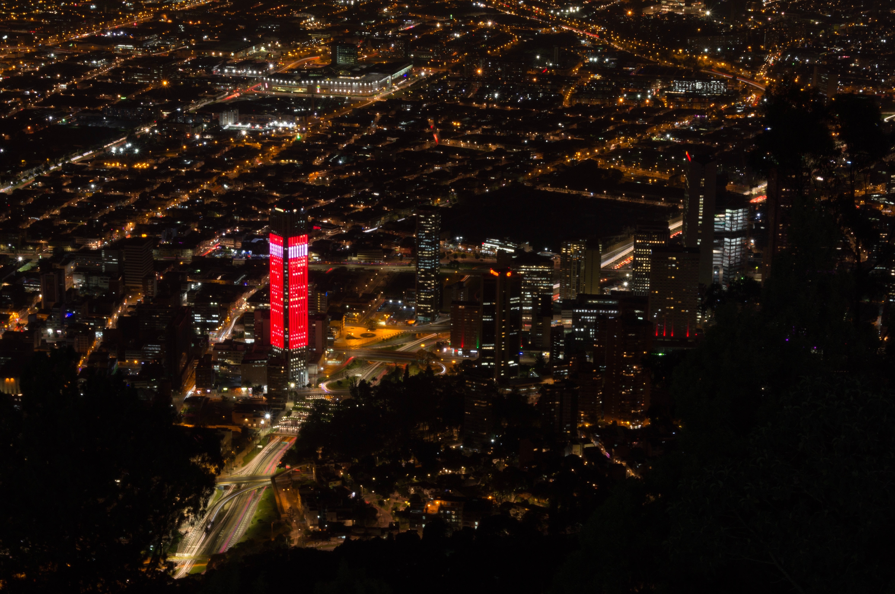
Context
Bogotá, Colombia
Population: ~8 million
Urban area: ~1,587 km²
Violence and war in the recent past.
No previous safety study found.
INTERNATIONAL CONFERENCE ON COMPLEX SYSTEMS 2018
Notes:
Trying to end a 60 year old war with rebels.
High impact of drug cartels in the recent past.
Area of 613 square miles.
Stats from DANE and Wikipedia.
Big metropolis with recent violence and crime issues, no safety study ever made available. Makes for an interesting candidate city for this project.
Although some practical work exists in the US, only some academic papers regarding mostly high level information exist on virtually the rest of the world.

Slide 4
Main Goals
Programmable city map
Urban traffic analysis
Urban security analysis
Best path routing
INTERNATIONAL CONFERENCE ON COMPLEX SYSTEMS 2018
Notes:
Need a city map that can allow us to integrate, visualize and use data with street level resolution.
Urban traffic and security analysis for visualization.
Best path routing as an enhanced GPS.

Slide 5
Programmable City Map
How to define a city in a simple georeferenced way?
How to have such a representation of a city in a programming language?
INTERNATIONAL CONFERENCE ON COMPLEX SYSTEMS 2018
Notes:
At a low level, point by point, what is a city? A network graph, where points are street intersections and edges are streets.

Slide 6
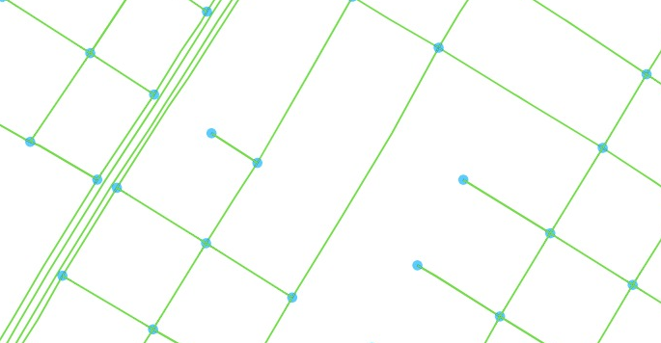
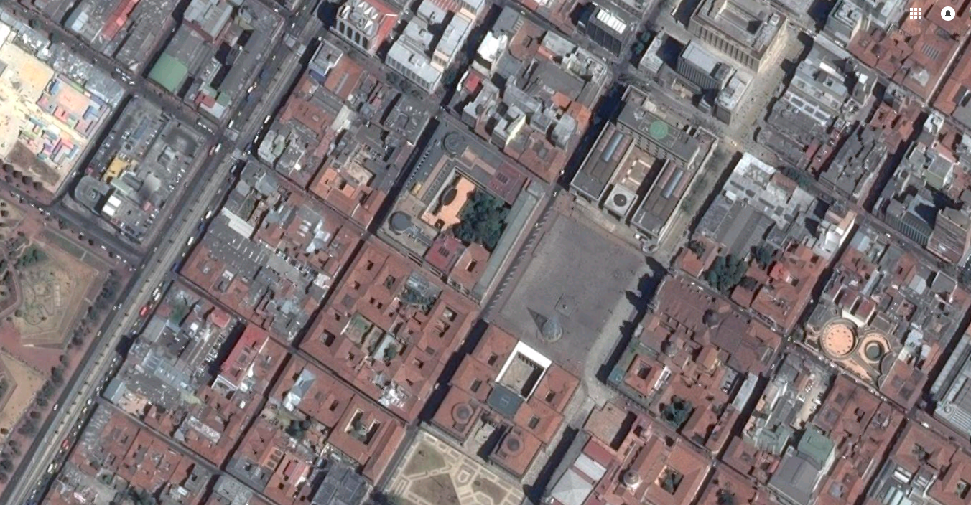
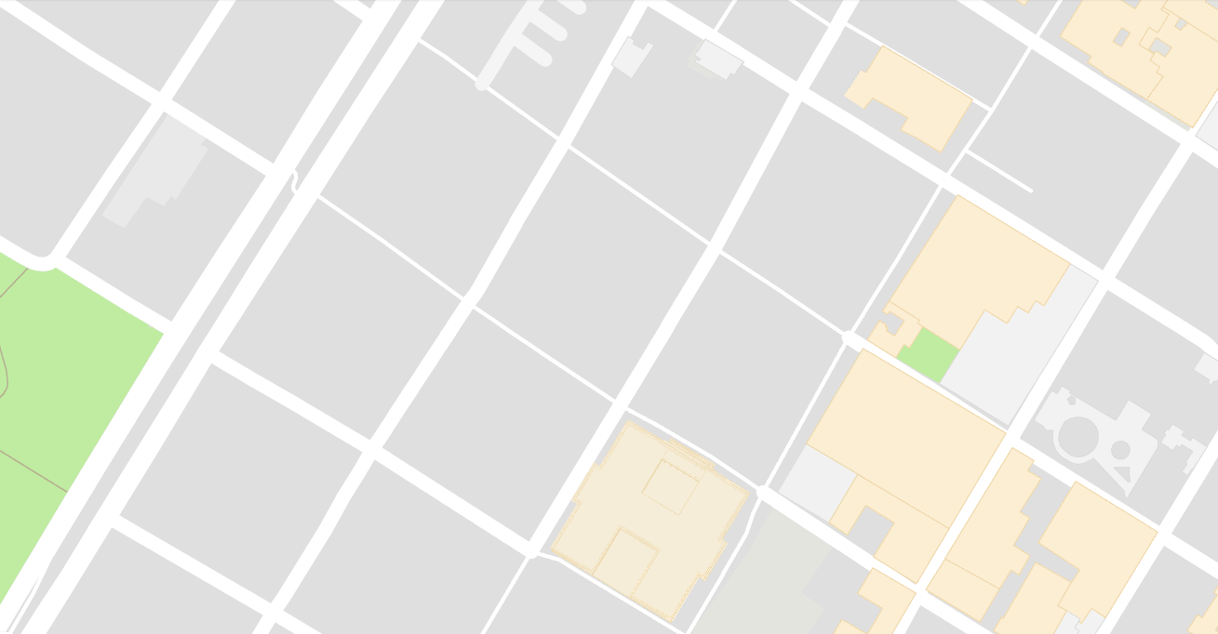
Programmable City Map
INTERNATIONAL CONFERENCE ON COMPLEX SYSTEMS 2018
Notes:
OSMnx uses data from Open Street Maps and tools from NetworkX to get a graph of any part of the world, with street intersections as nodes and streets as edges.
Try to get a graph of another part of the city, without missing nodes.

Slide 7
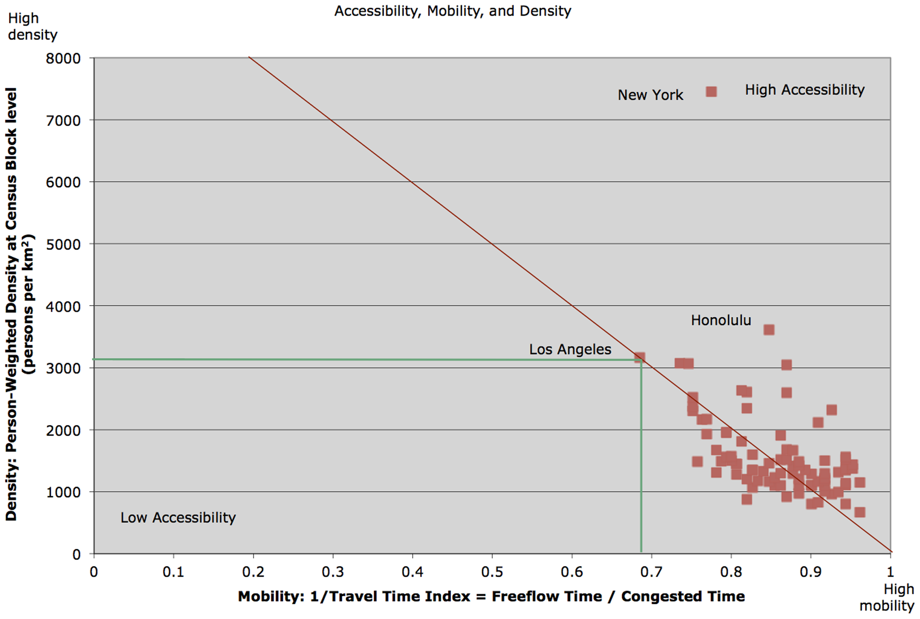
Urban Traffic Analysis
Logic
* Graph taken from “Network Structure and City Size”, by David Levinson in PLOS ONE 2012
INTERNATIONAL CONFERENCE ON COMPLEX SYSTEMS 2018
Notes:
Explain why using population density to figure out the risk of traffic jams / intensity.

Slide 8
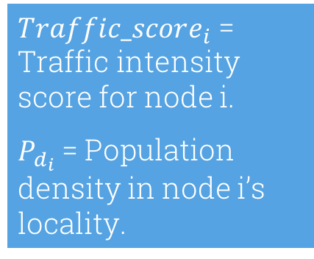

Urban Traffic Analysis
Logic
Population density tends to deteriorate mobility.
$Traffic_score_{i}$ = Traffic intensity score for node i.
$P_{d_{i}}$ = Population density in node i’s locality.
$$Traffic_score_{i}=P_{d_{i}}$$
INTERNATIONAL CONFERENCE ON COMPLEX SYSTEMS 2018

Slide 9
Urban Traffic Analysis
Data sources
Population density
Number of locality inhabitants per square kilometer.
DANE national statistics
institute of Colombia
(
)
INTERNATIONAL CONFERENCE ON COMPLEX SYSTEMS 2018

Slide 10
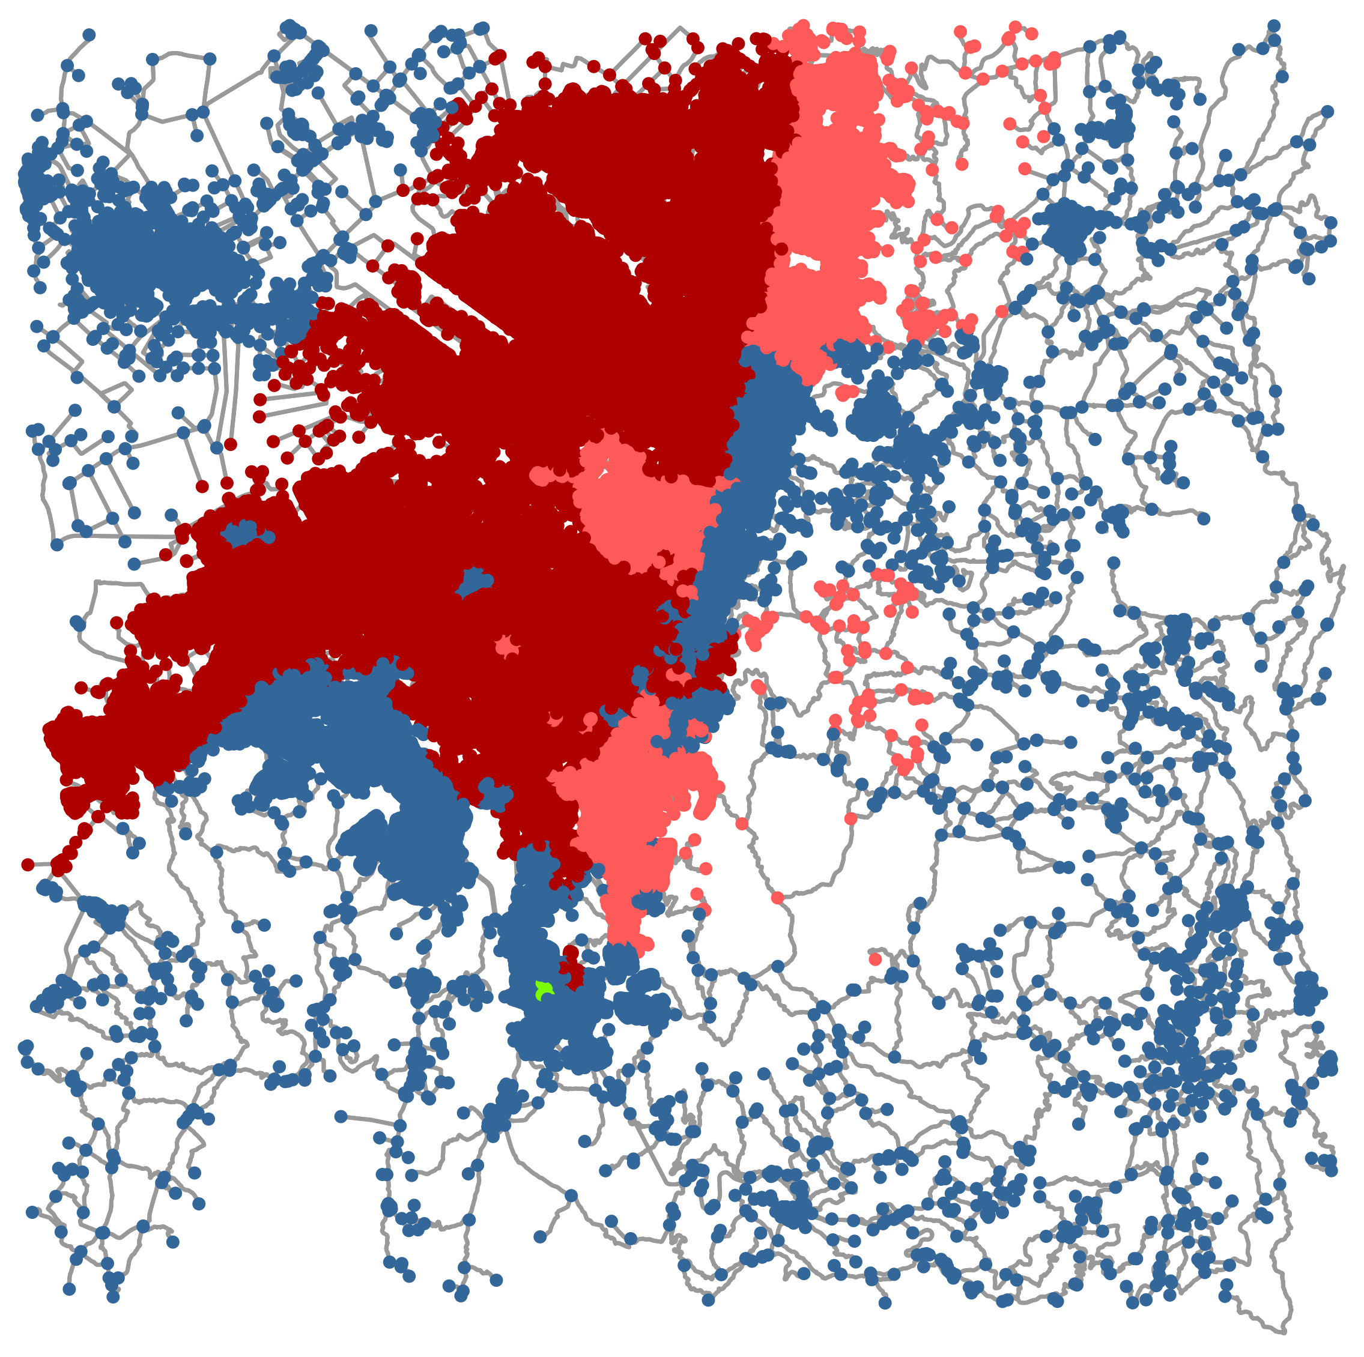
Urban Traffic Analysis
Results
Unfavorable traffic conditions all around the capital city.
Regular transit in parts of the east.
INTERNATIONAL CONFERENCE ON COMPLEX SYSTEMS 2018

Slide 11


Urban Security Analysis
Logic
Crime reports are a good measure but can be incomplete.
Poverty conditions have been linked with violence but aren’t necessarily equivalent to criminal activity.
$C_{d_{i}}$ = Criminal density for node i
$Pv{r_{d}}_{i}$ = poverty proportion of the population for node i
$k_{c} , k_{p}$ = crime and poverty weights
$$Unsafety_score_{i}=k_{c}C_{d_{i}}+k_{p}Pv{r_{d}}_{i}$$
INTERNATIONAL CONFERENCE ON COMPLEX SYSTEMS 2018

Slide 12
Urban Security Analysis
Data sources
Crime records
Poverty conditions
59225 diverse criminal activities between 2010 and 2015
Proportion of the population living in low social stratum
Open Data Bogotá city’s open data
initiative
(
)
SISCRED Bogotá’s cultural information system
(
)
INTERNATIONAL CONFERENCE ON COMPLEX SYSTEMS 2018

Slide 13
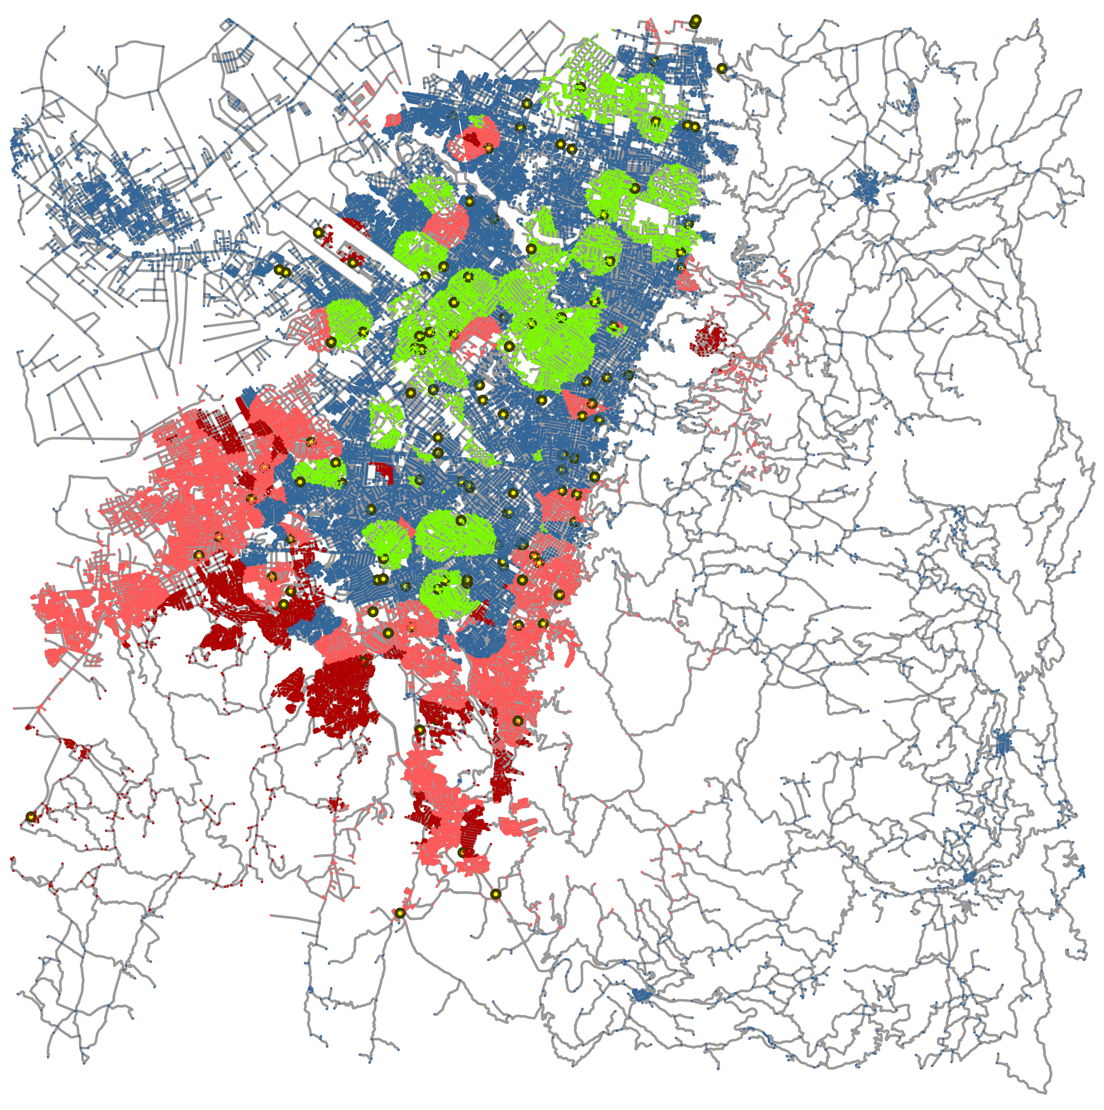
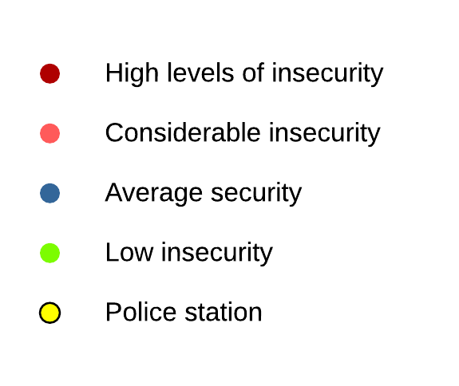
Urban Security Analysis
Results
Safer central/northern region.
Unsafe south and border regions.
Southern police stations are currently ineffective.
INTERNATIONAL CONFERENCE ON COMPLEX SYSTEMS 2018
Notes:
Lower than 2 the average for the green color, bigger than the 9 average for the light red color, bigger than two times the average for the darker red color and all the rest as a blue color.

Slide 14


Best path routing
Logic
Distance affects travel time but traffic also has an impact.
Some people may want to minimize safety risks during trips.
$w_{ij}$ = Edge weight between nodes i and j
${dist}_{ij}$ = Distance between nodes i and j
$saf_{ij}$ = Average unsafety scores.
${traf}_{ij}$ = Average traffic scores.
$k_{d} , k_{s}, k_{t}$ = distance, safety and traffic weights.
$$w_{ij}=k_{d}{dist}_{ij}+k_{s}saf_{ij}+k_{t}{traf}_{ij}$$
INTERNATIONAL CONFERENCE ON COMPLEX SYSTEMS 2018
Notes:
Explain why using population density to figure out the risk of traffic jams / intensity.
No longer consider just the distances or traffic at current time, but also safety and traffic scores of each point.

Slide 15
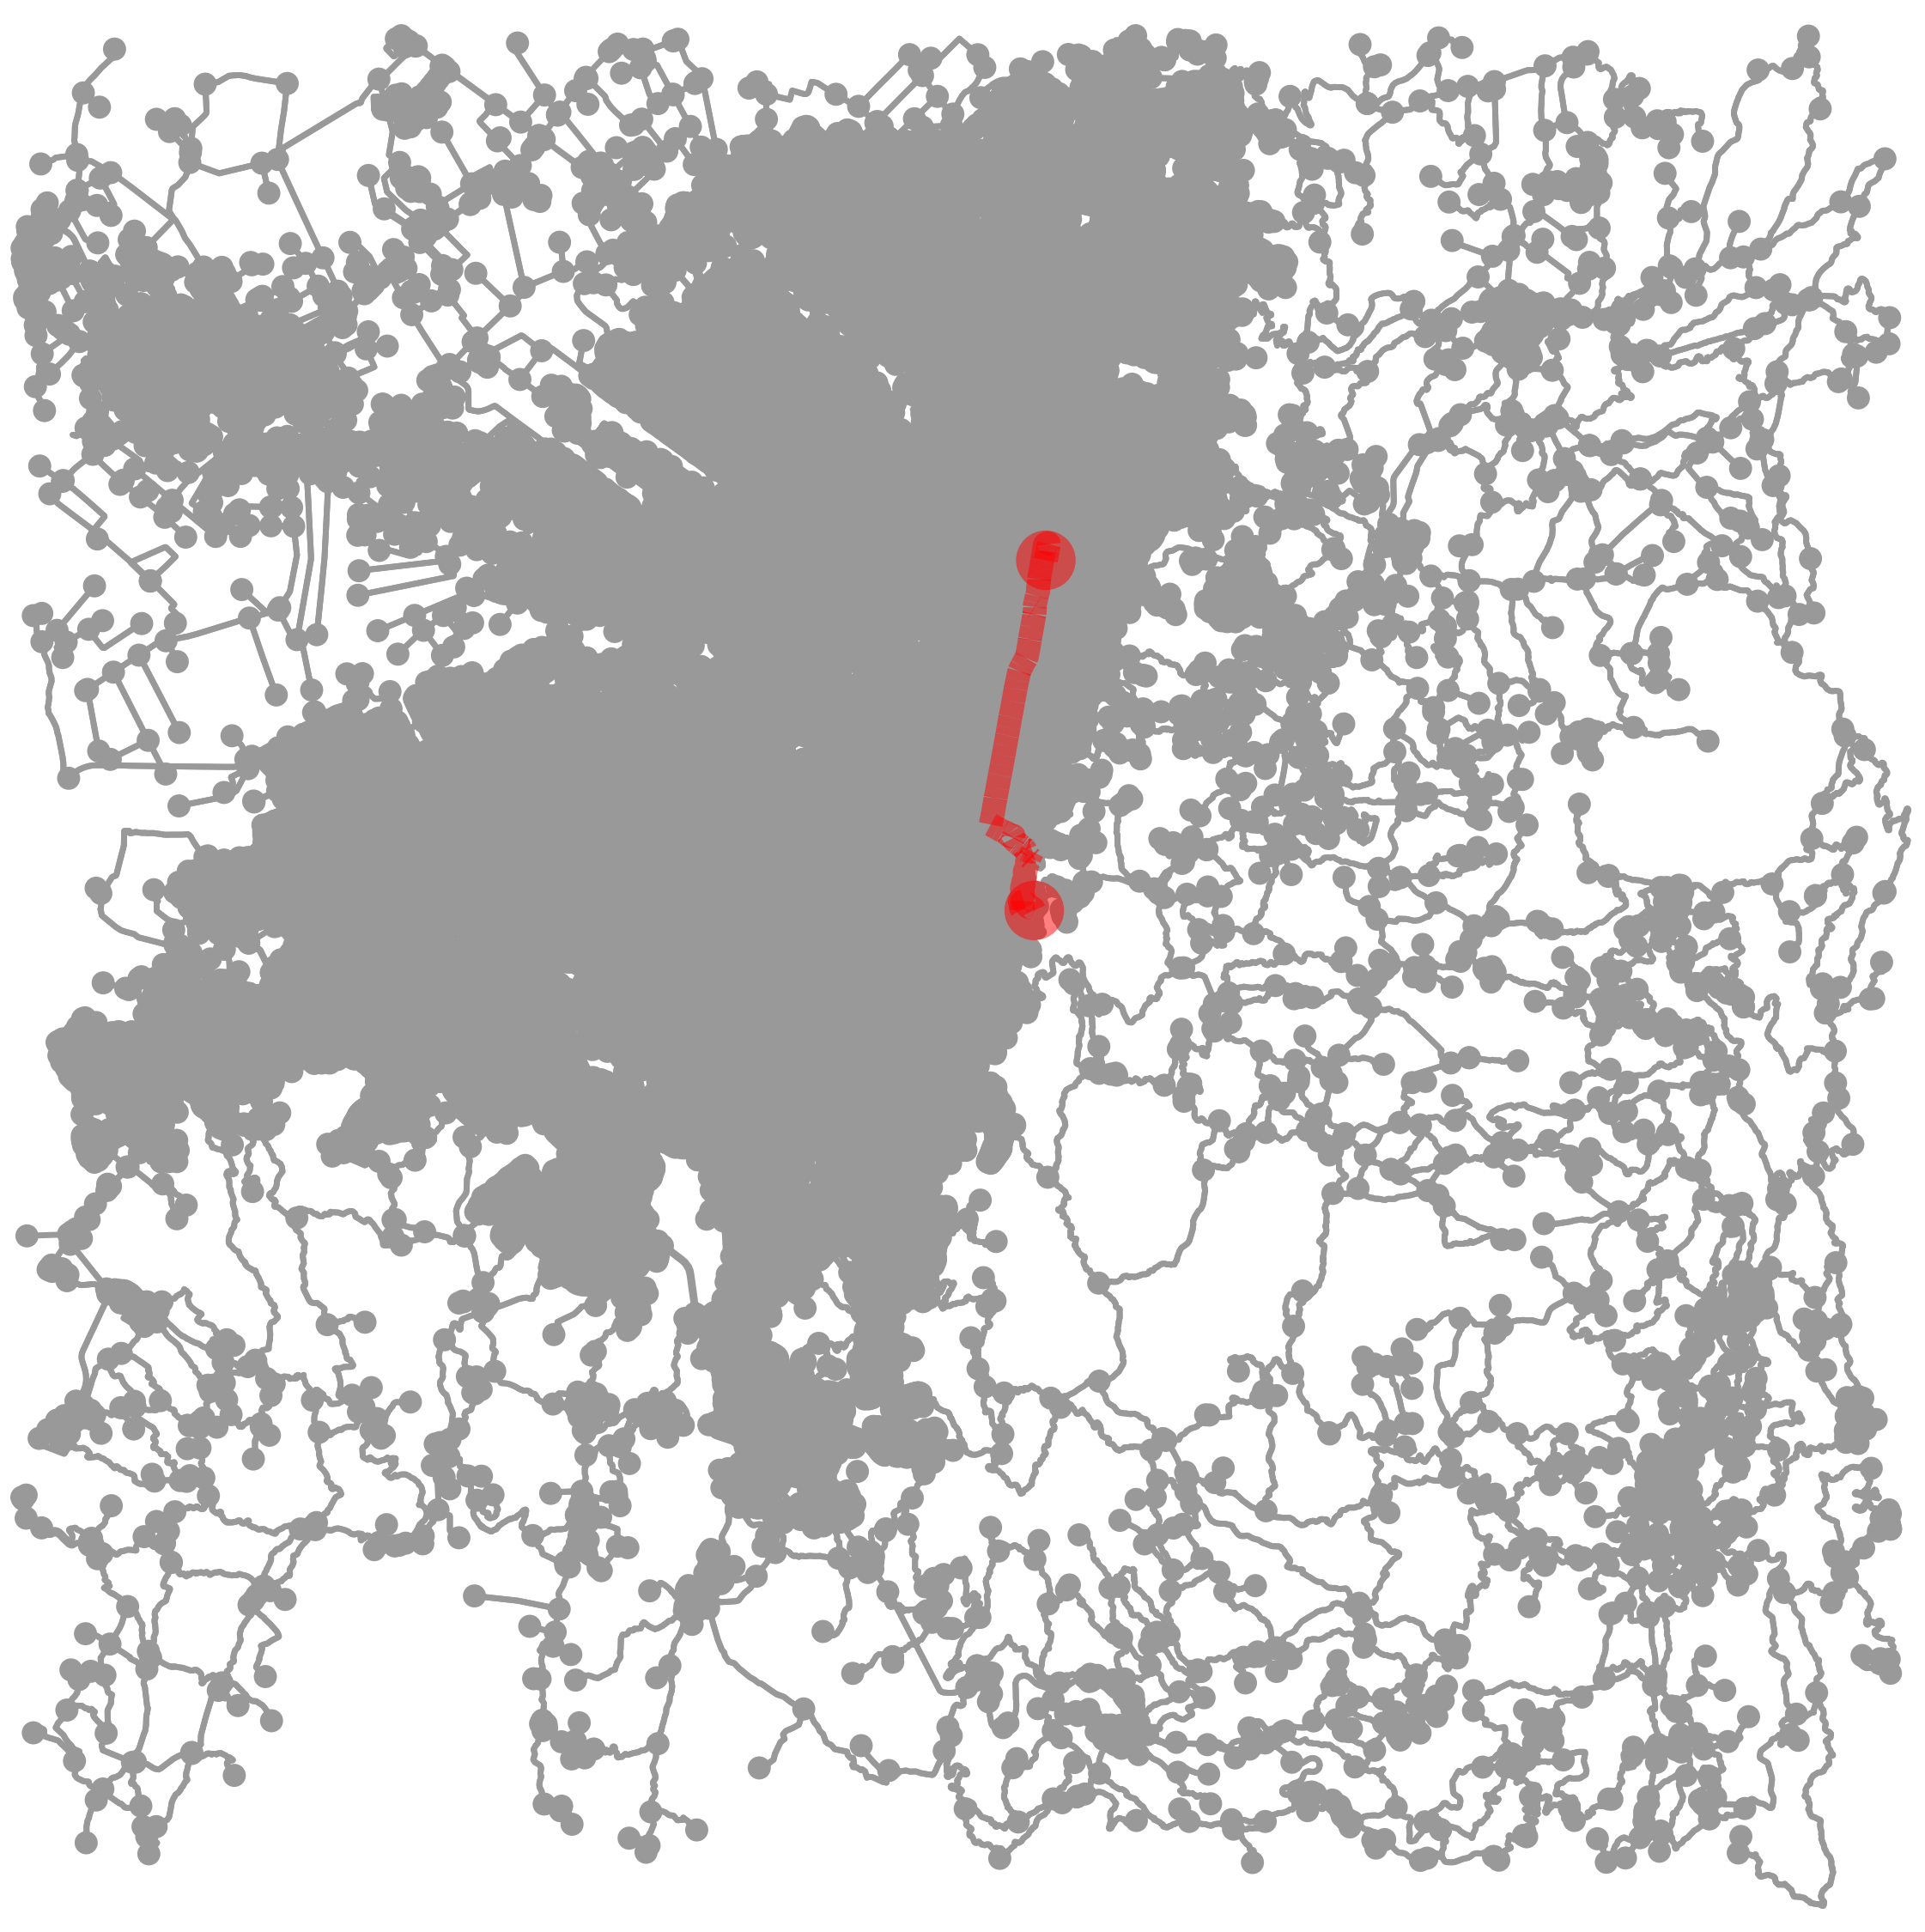
Best path routing
Results
INTERNATIONAL CONFERENCE ON COMPLEX SYSTEMS 2018

Slide 16
Implications
INTERNATIONAL CONFERENCE ON COMPLEX SYSTEMS 2018
Notes:
Population density is interesting to predict traffic intensity. However, other factors such as average circuity or the percentage of the population that uses public transports could improve the quality of the traffic score.

